Slide 1

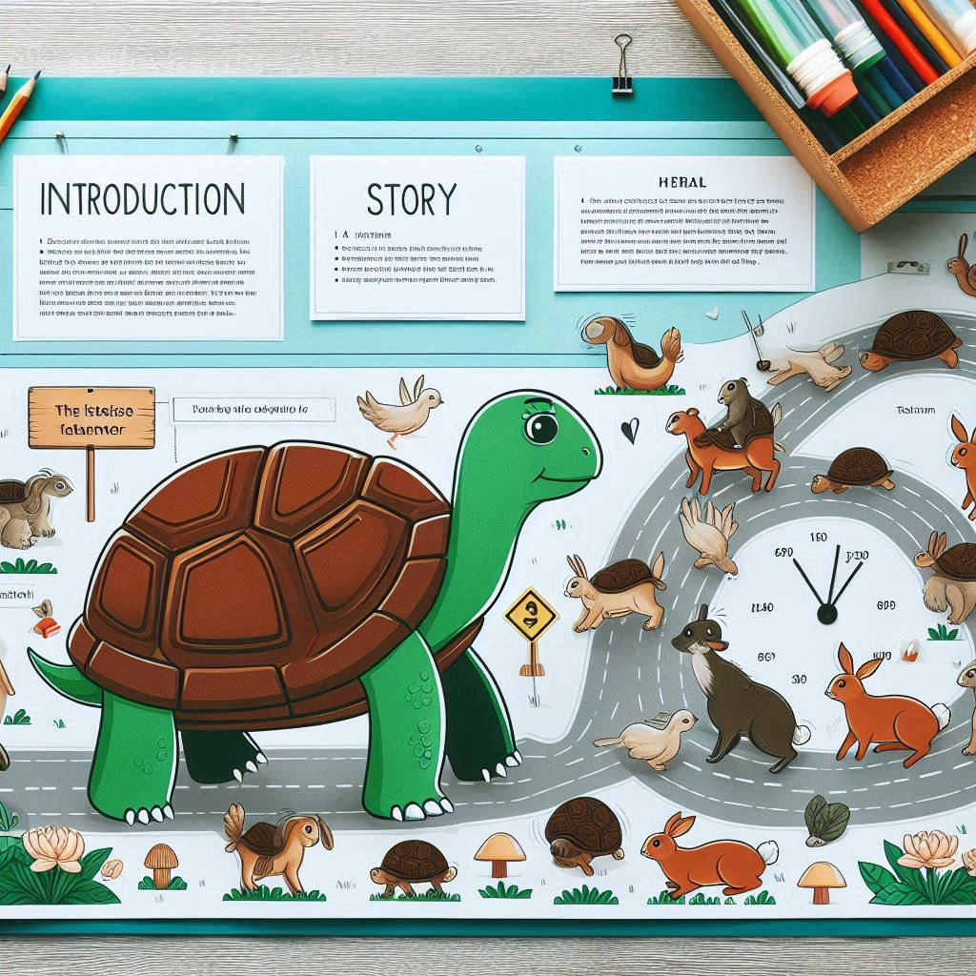
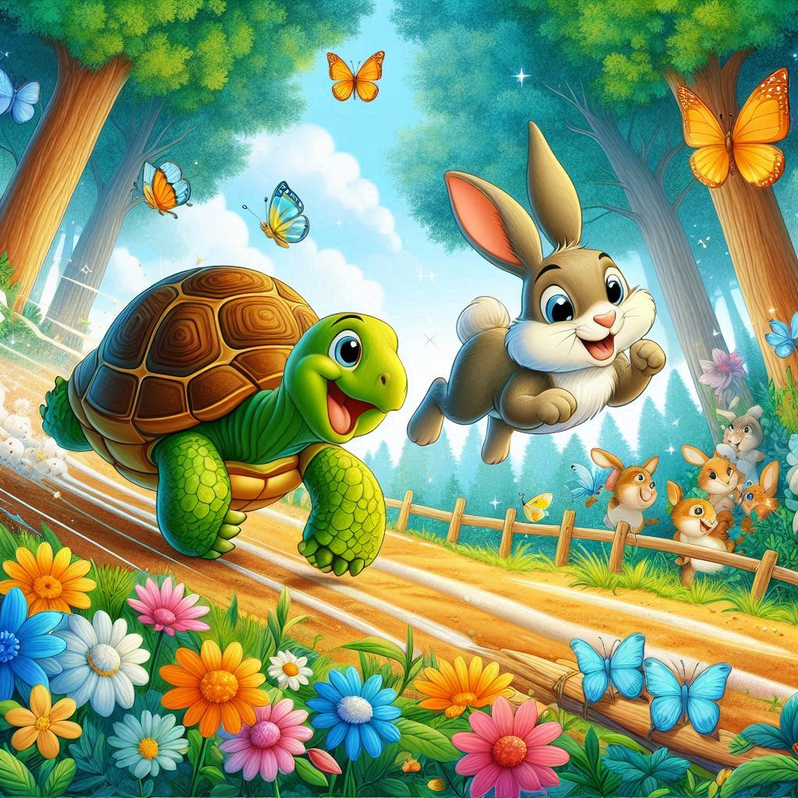

The Tortoise and Hare : A lesson in Perseverance
This presentation explores the well-known fable of the Tortoise and the Hare, which has been a significant narrative for generations. It emphasizes the moral that perseverance and steady effort can overcome natural talent and speed.

Slide 2






Introduction to the Fable
In the classic tale of the
, we discover that and can triumph over and
and the
. This
presentation explores the valuable lessons we can learn from this timeless story and how they apply to our lives.

Slide 3





The Race
In the race, the hare shot off like lightning, confident that victory was guaranteed. Speed was its strength, and it believed no one could catch up.
But as the race wore on, the hare grew overconfident, thinking it had plenty of time to rest. This belief in its own superiority became the hare’s greatest challenge.

Slide 4



The Turning Point
As the hare rested, certain of its lead, the tortoise kept moving, slow but steady. This was the turning point—the hare's overconfidence had caused it to lose focus, while the tortoise's persistence paid off.
By the time the hare realized its mistake, it was too late. The tortoise crossed the finish line, achieving an unexpected but well-earned victory.

Slide 5





Conclusion: Embrace the Journey
The moral of the story is clear: truly wins the race. Embracing a and approach allows us to navigate life's challenges
effectively. Let us remember that every journey is valuable, regardless of its
pace.

Slide 6



Thank You!
Give us your valueable feedback! Scan Me !

